Slide 1

Automatic Image Captioning Generating Descriptive Captions for Images
Group 7
Team Members:
Kusal Degapudi
Pradeep Reddy Pochareddy
Raja Rama Krishna B
Sai Nikhil Yanduri
Mentor:
Seshadri Mazumder
Professor:
Dr. Vineet Gandhi

Slide 2
Agenda
Problem Statement
Data and Pre-processing
Model Architecture
Training and Test Results
Discussions and Model Baselining
Model Deployment

Slide 3
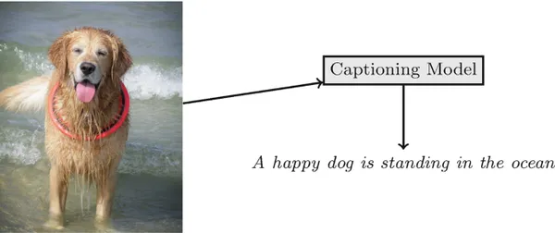
Problem Statement
Image Caption Generator is used to recognize the context of an image and to generate natural sentence description for given image.
This innovative solution integrates computer vision and natural language processing (NLP) that unlocks exciting possibilities across various domains.
Potential applications for this solution are like Accessibility for the Visually Impaired, Enhanced User Experiences in Social Media, E-Commerce sites.

Slide 4
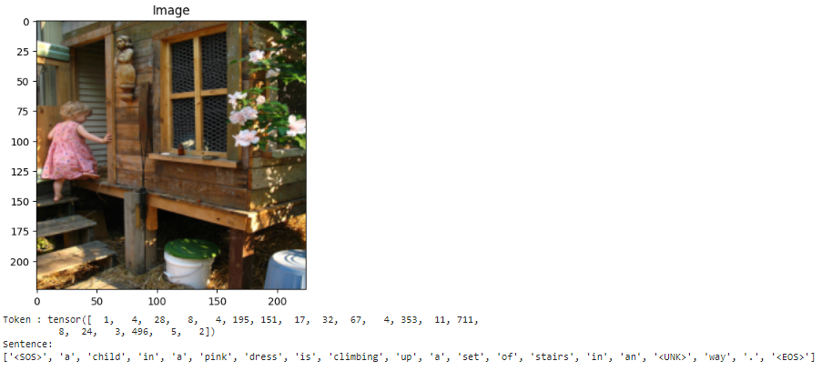
Dataset and Pre-processing
Dataset Flickr8k: Contains 8,000+ images with 5 captions each and Token size 8787.
Dataset Flickr30k: Contains 30,000+ images with 5 captions each and Token size of 19775.
Both 8K and 30K Datasets split as Train-70%, Test-20% & Validation-10%
Data Pre-processing:
Images are resize as coloured at 224 x 224 x 3 dimension
Captions curated to bring into same format between Datasets for loading and processing
Tokenization of captions
Building Vocabulary
Example of tokenized caption: ["<SOS>", "a", "dog", "is", "running", "in", "a", "field", "<EOS>"]
Conversion of captions to numeric and vice versa

Slide 5
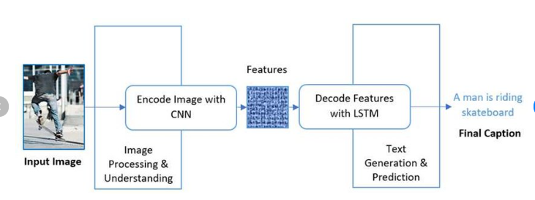
Model Architecture
Encoder-Decoder Framework
Encoder
Convolutional Neural Networks (CNN) - ResNet50/CLIP (pre-trained) was used to extract the features from the image
Decoder
Long short-term memory (LSTM) with multi-head attention model used to caption the image based on features extracted from the encoder

Slide 6
Experiments
We evaluated the performance of three different image captioning models on the Flickr8k and Flickr30k datasets. Each model was tested for its ability to generate accurate captions based on BLEU scores and similarity metrics.
Models Evaluated:
ResNet-LSTM:
Image features extracted using a pre-trained RESNET model.
Captions generated using an LSTM decoder.
CLIP-LSTM:
Features extracted using the CLIP (ViT-B/32) model.
Captions generated using an LSTM decoder.
CLIP-LSTM with Attention:
Features extracted using the CLIP (ViT-B/32) model.
Captions generated using an LSTM decoder with additional multi head attention layer

Slide 7
Evaluation Metrics
BLEU2, BLEU3 and BLEU4 scores calculated to assess the model performance after each training epoch on validation data, also calculated on test data after completion of training.
Sentence similarity scores calculated between actual and predicted caption after each training epoch on validation data, and on test data after completion of training.
bert-base-nli-mean-tokens model was used to calculate similarity scores.

Slide 8
ResNet-LSTM
Model: 1

Slide 9
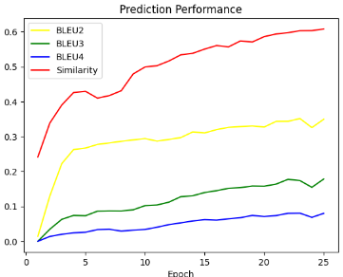
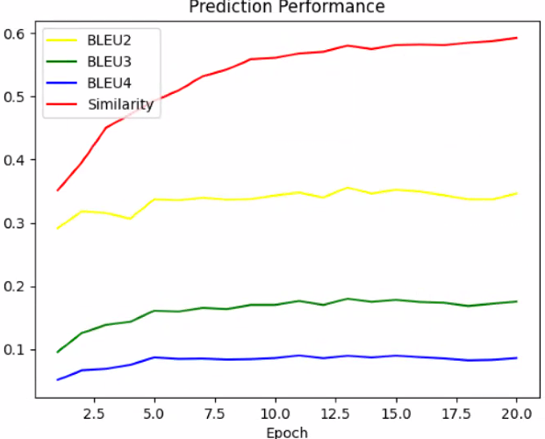
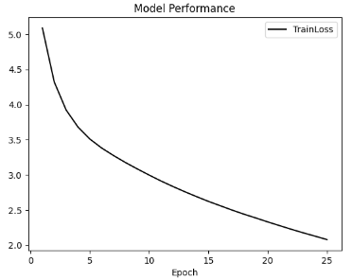
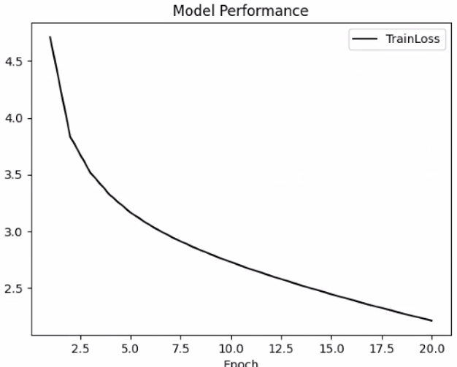
Model Training
ResNet feature vector size 512 LSTM Hidden Size 512 Number of LSTM Layers 3 Optimizer Adam Learning Rate 0.0001 Loss Function Cross-entropy Training Results after 25 epochs for 8k Model: Evaluation metric : BLEU2 score 0.35, BLEU3 score 0.18 & BLEU4 score 0.08 Similarity Score is 0.61 Training Results after 20 epochs for 30K Model: Evaluation metric: BLEU2 score 0.34, BLEU3 score 0.17 & BLEU4 score 0.08 Similarity Score is 0.59 | 8K Model | 30K Model
Train Scores
Train Scores
Train Loss
Train Loss

Slide 10
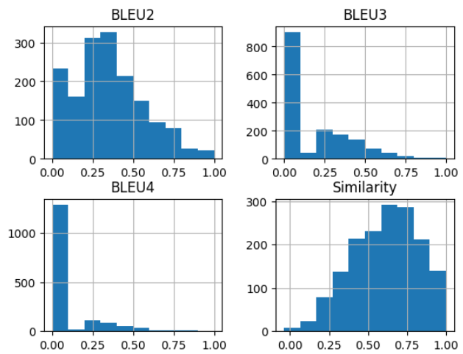
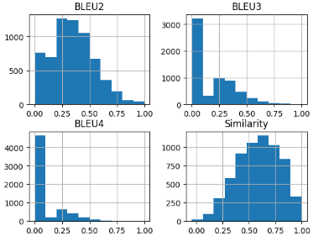
Model Testing
8K Model
30K Model
8K Dataset Test Scores
30K Dataset Test Scores

Slide 11
CLIP-LSTM
Model: 2

Slide 12
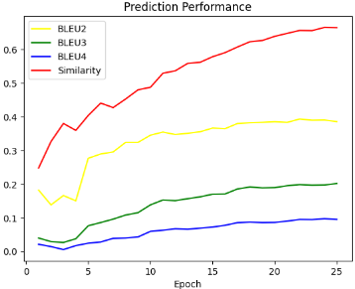
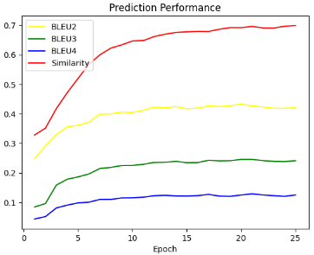
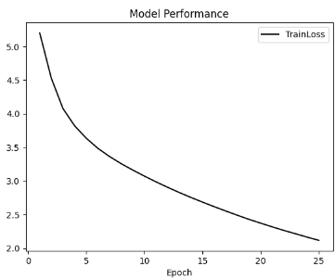
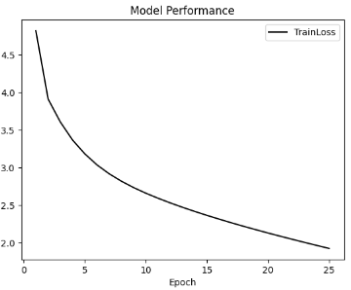
Model Training
CLIP(ViT-B/32) feature vector size 512 LSTM Hidden Size 512 Number of LSTM Layers 3 Optimizer Adam Learning Rate 0.0001 Loss Function Cross-entropy Training Results after 25 epochs for 8K model: Evaluation metric: BLEU2 score 0.38, BLEU3 score 0.20 & BLEU4 score 0.1 Similarity Score is 0.66 Training Results after 25 epochs for 30K model: Evaluation metric: BLEU2 score 0.42, BLEU3 score 0.24 & BLEU4 score 0.12 Similarity Score is 0.70 | 8K Model | 30K Model
Train Scores
Train Scores
Train Loss
Train Loss

Slide 13
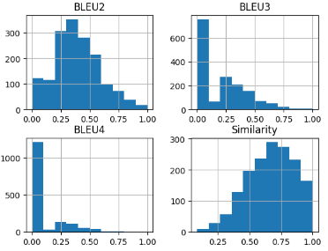
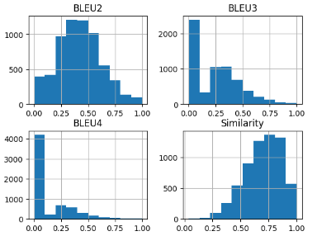
Model Testing
8K Model
30K Model
8K Dataset Test Scores
30K Dataset Test Scores

Slide 14
CLIP-LSTM Attention
Model: 3

Slide 15
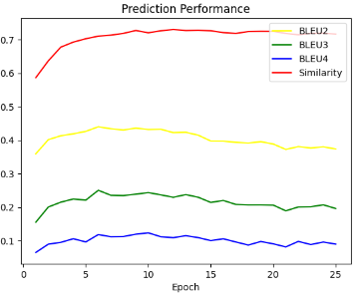
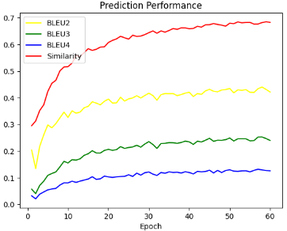
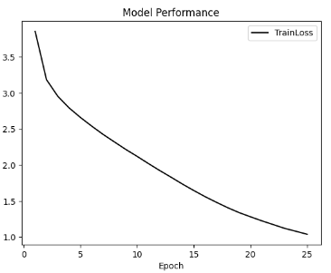
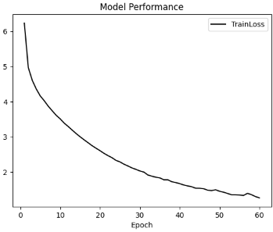
Model Training
CLIP(ViT-B/32) feature vector size 512 LSTM Hidden Size 512 Number of Multi-Heads 8 Number of LSTM Layers 3 Optimizer Adam Learning Rate 0.0001 Loss Function Cross-entropy Training Results after 25 epochs for 8K model: Evaluation metric: BLEU2 score 0.37, BLEU3 score 0.19 & BLEU4 score 0.09 Similarity Score is 0.71 Training Results after 60 epochs for 30K model: Evaluation metric: BLEU2 score 0.42, BLEU3 score 0.24 & BLEU4 score 0.12 Similarity Score is 0.69 | 8K Model | 30K Model
Train Scores
Train Scores
Train Loss
Train Loss

Slide 16
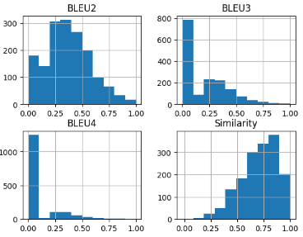
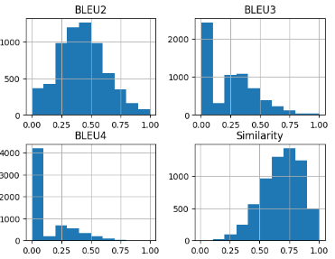
Model Testing
8K Model
30K Model
8K Dataset Test Scores
30K Dataset Test Scores

Slide 17
Results

Slide 18
Discussions and Model Baselining
Richer Features with CLIP: The CLIP model provided richer features compared to ResNet, leading to better captioning inferences with the same decoder model.
Improvement with Multi-head Attention: Adding a multi-head attention layer in the decoder improved grammatical correctness and increased BERT similarity scores for captions.
Impact of Batch Size: Model accuracy was sensitive to batch size. Larger batch sizes required more epochs for improved accuracy, while smaller batch sizes increased training time per epoch but resulted in better accuracy by the end of training.
Compute Intensity and GPU Costs: Training image captioning models is compute-intensive, raising GPU costs. To mitigate this, image embedding were pre-processed and stored in a pickle file for faster training and validation.
BLEU Score Observations : BLEU-3 and BLEU-4 scores were lower due to exact word sequence mismatches in some captions, which led to zero scores. However, BERT scores were higher, indicating that many captions were still of high quality.
Out of 1618 observations, 1121 had BLEU4 scores of zero, but the average similarity score was 0.73, with 720 observations achieving a similarity score above 0.70.
An example mismatch includes the predicted caption "a group of dogs are running in a field" and actual captions like "A man with four running dogs in nature" and others, reflecting context but not exact word matches.

Slide 19
Discussions and Model Baselining
Ambiguity in Actions or Context: The model struggles when it comes to capturing the finer details of what’s happening in a scene. For example, if someone is riding a specific type of motorcycle, the model might just say “someone is riding through mud,” missing important context like the type of motorcycle or the precise action. It tends to generalize when the action is more detailed or nuanced.
Object Recognition Errors: The model sometimes gets confused when there are multiple or less common objects in the image. For instance, it might describe a camel as a horse or forget to mention something important like a dog carrying a stick. It can miss or misidentify key objects, which makes the caption less accurate.
Simplified Descriptions: When there’s a lot happening in a scene or multiple subjects in the frame, the model often picks up on only the most obvious thing and ignores the rest. It might describe a person standing without mentioning the interaction with other objects or people, making the caption feel incomplete or overly simple.
Incorrect Identifications of Animals or People: Sometimes, the model just gets it wrong when describing animals or people. For instance, it might call a “blonde dog digging a hole” a “white dog standing up,” which changes the scene completely. These errors can make the caption feel out of touch with what’s actually happening.
Baselining: Based on above results both 8K and 30K CLIP-LSTM with Attention network model performing better. This can be used for further improvements.

Slide 20
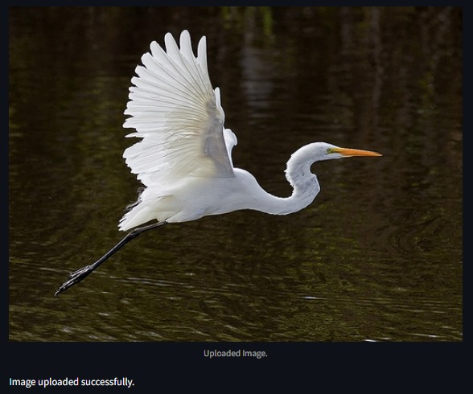
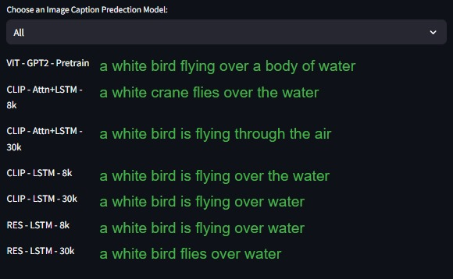
Model Deployment
We made the image captioning model accessible to users via a simple and interactive web interface by using following using StreamLit and Ngrok.
https://github.com/RRKBHUVANA/ImageCaptioningIIIT

Slide 21
Q&A
Thanks

